Slide 1



Presented By Underground
MOVIE RECOMMENDATION CHATBOT

Slide 2



Key poInts
1
IntroductIon
2
ArchItecture
3
Example of user Interaction
4
System benefIts
5
future enhancements

Slide 3




INtroductION
Virtual Assistants AI-powered assistants.
A conversational AI system that recommends movies tailored to user preferences. It understands natural language queries, semantically searches a movie database, and replies with relevant suggestions
.
Use case
Use cases include personalized entertainment guidance on streaming platforms, virtual assistants, and interactive kiosks.

Slide 4
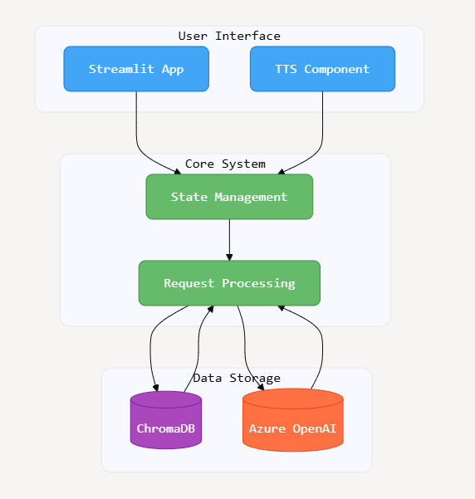
ArchItecture OvervIew

Slide 5
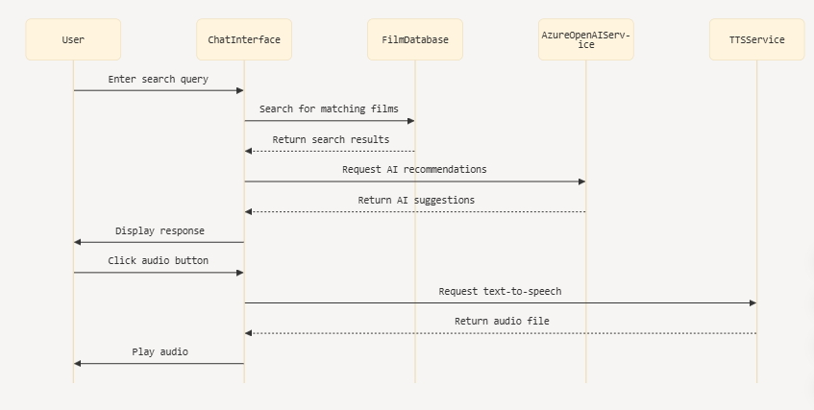
Sequence dIagram

Slide 6



BenefIts of the System
Personalized Recommendations
Fast Semantic Search
Tailors suggestions based on nuanced user preferences and context.
Leverages vector embeddings for swift and accurate content discovery.
Voice Interaction
Engages users through natural audio responses, enhancing accessibility.

Slide 7
Future Enhancements & Next Steps
Implement user profiles for richer personalization
Incorporate emotional tone detection in conversations
Expand movie metadata and real-time updates

Slide 8



THANK YOU

